Slide 1
Edge Detection

Slide 2
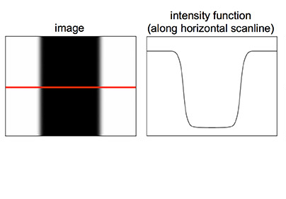
What is an edge?
An edge is a place of rapid change in the image intensity function.
http://stanford.edu/

Slide 3
Edge detection
Is a very important step in a lot of image processing and computer vision algorithms. Edges are usually meaningful!
Can you think of some of these applications?

Slide 4
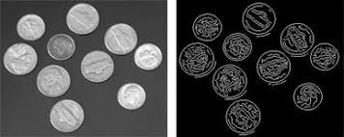
Applications of Edge detection
Isolating/recognising objects in image

Slide 5
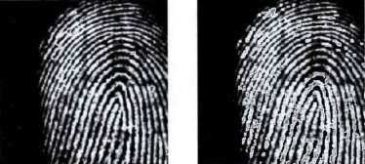
Applications of Edge detection
Fingerprints

Slide 6
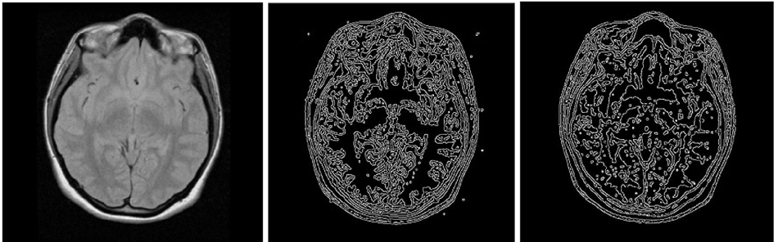
Applications of Edge detection
Medical Imaging

Slide 7
Different edge detection algorithms
Sobel Operator
Laplacian Operator
Canny Operator

Slide 8
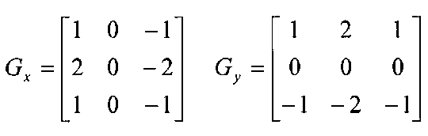
Sobel Operator
one of the most commonly used edge detectors
based on convolving the image with a small, separable, and integer valued filter in horizontal and vertical direction

Slide 9
Sobel Operator
In the masks, the center column and centre row are zeros, because it does not include the original values of an image but rather it calculates the difference of right and left pixel values around that edge.
Thus increasing the sudden change of intensities and making the edge more visible

Slide 10
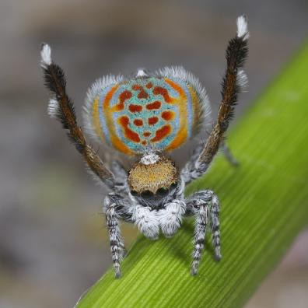
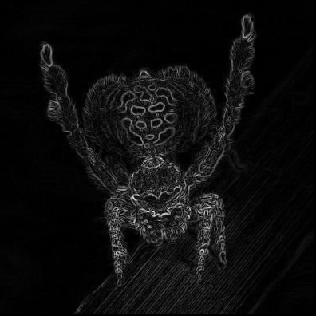
Sobel Operator
original
sobel

Slide 11
Sobel Operator
Pros
relatively inexpensive in terms of computations.
Cons
poor Localization, which means you will see many edges which actually could have been reduced to only 1 edge.

Slide 12
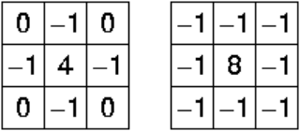
Laplacian Operator
Unlike the Sobel edge detector, the Laplacian edge detector uses only one kernel
Sobel measures the slope while the Laplacian measures the change of the slope.
These kernels are very sensitive to noise. To correct this, the image is often Gaussian smoothed before applying the Laplacian filter.
Two commonly used small kernels are:

Slide 13
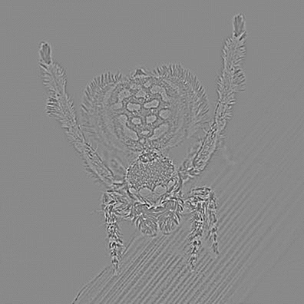
Laplacian Operator
original
Laplacian

Slide 14
Laplacian Operator
Pros
even more inexpensive in terms of computations than Sobel
Cons
poor localization as well
and highly sensitive to noise

Slide 15
Canny Operator
probably the most commonly used and most effective method
also most complex!
Steps involved:
Smooth the image (with a Gaussian filter) to reduce noise (already covered)
Compute gradient using Sobel (already covered)
Non-maximum suppression (more to come)
Tresholding (more to come)
Hysteresis (more to come)

Slide 16
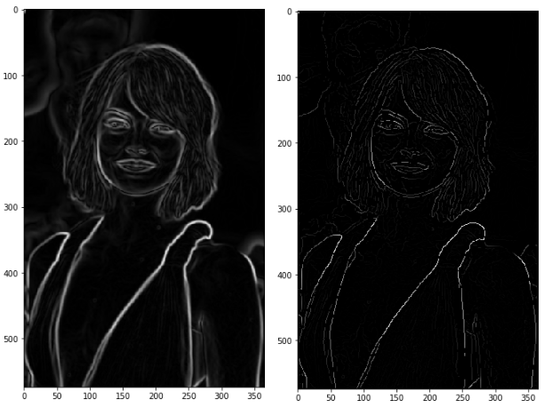
Canny Operator - Non-maximum suppression
This step attempts to reduce the number of detected edges
Those that do not meet certain criteria are suppressed
After this step we should have thinner looking edges (less clutter)
Before suppression
After suppression

Slide 17
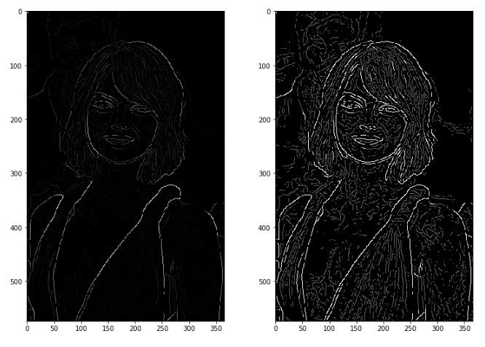
Canny Operator - Tresholding
Identifying 3 kinds of pixels: strong, weak, and non-relevant:
Strong pixels are pixels that have a high intensity (very important)
Weak pixels are pixels that have medium intensity (a bit important)
Other pixels are considered as non-relevant for the edge
After tresholding
Strong pixels -> white
Weak pixels -> grey
Others -> removed!
Before tresholding

Slide 18
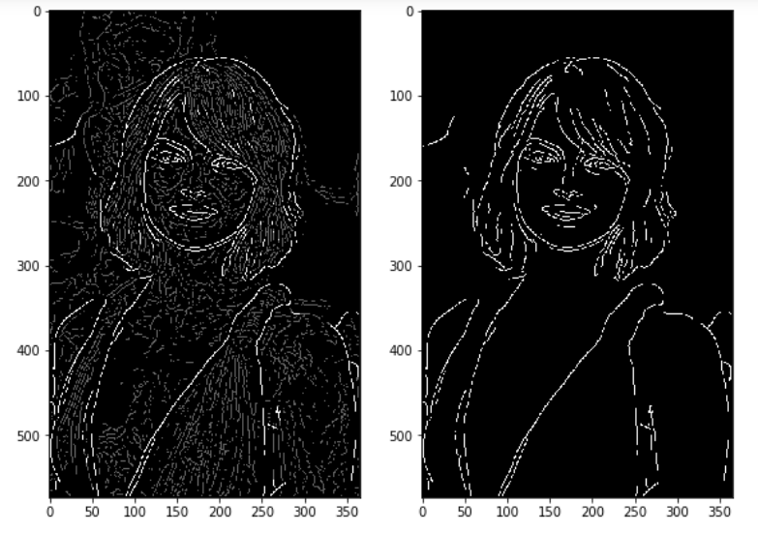
Canny Operator - Hysteresis
transforming weak pixels into strong ones, if and only if at least one of the pixels around the one being processed is a strong one
After hysteresis
Note: grey gone
(only b&w)
Before hysteresis

Slide 19
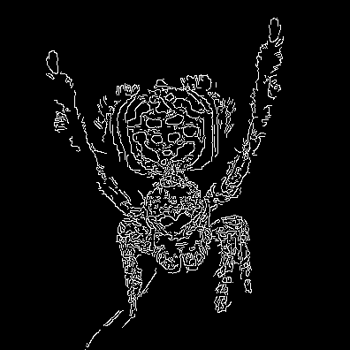
Canny Operator
original
Canny

Slide 20
Canny Operator
Pros
solves most problems of other edge detection algorithms
is better at detecting circular edges than other algorithms
Cons
more computationally expensive

Slide 21
Which??
So which edge algorithm is best to use depends heavily on the application.
Sobel and Laplacian are faster but Canny usually gives best results.

Slide 22
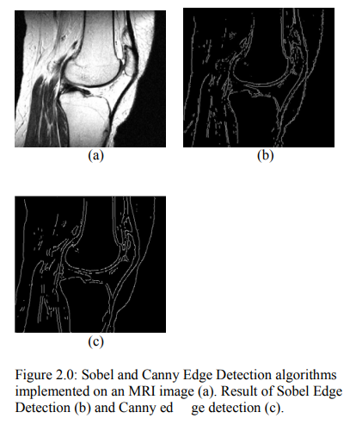
Suggested Read
https://comp.utm.my/wp-content/uploads/2013/04/Comparison-of-Canny-and-Sobel-Edge-Detection-in-MRI-Images.pdf

Slide 23
Questions?

